Slide 1
Training on Clouder Data Platform and MLOps/AIOps
Webinar on :
BigData Technology Stacks
Edges To AI Application On Hybrid Data Cloud &
Spark Application Performance Tuning
SESSION-01
Prepared and presenting by:
Amrit Chhetri
Cyber Security Architect & CEI(RCS/Rosefinch, Siliguri, West Bengal)
DFIR Expert|AI, Cyber Security & Digital Forensics Researcher
Certified Forensic Psychologist,
Associate Technical Editor(4N6)
Tech Speaker and Forensic Researcher
Member Of: DSCI( Individual) & Nasscom Community
(Contents: OSS License)

Slide 2
Session from Day 1( 8 Hours)
BigData Technologies

Slide 3
Agendas:
BigData Components and Architecture
Data Lake and Database Systems
BigData and AI on Cloud Platforms
CDP Access And Administration(Basic)
BigData Developer Platform-Hadoop, Spark & Scala
Labs. of Session 1- On BigData Technology
BigData Quotient Assessment- Short Hackathons, CTFs & Quiz

Slide 4
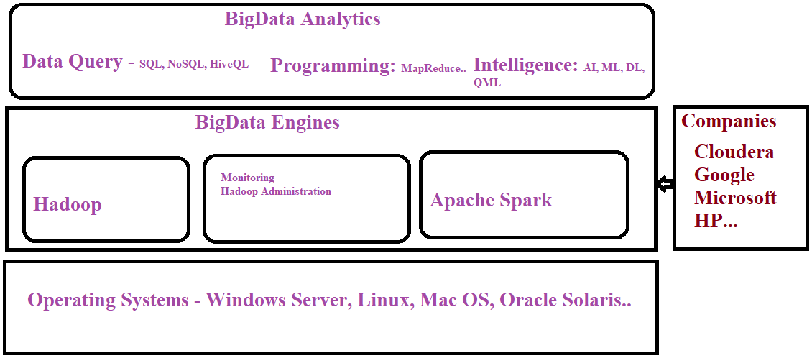
BigData Components & Architecture:
(1,Defining BigData and Challenges)
BigData Technology-2 Minutes Understand:
Context: BIgData Definition, Comapanies, Programming, DevOps(Development), DevSecOps(Cyber Security), Design Principles( ZTA, Architecture by Domains,
Secure By Design, Secure Coding, Cyber Resilience with SOC Technology)
BigData Technology- 6Vs :
  BigData is a Database Technology for Storing and Processing Huge Volume of Data
  It is large set of data and follows 6Vs- Volume, Variety, Velocity, Value, Veracity, Variability- which are not supported in Traditional Data Processing Systems
  "BigData is a collection of very large set of data which includes structured ,semi-structured and non- structured data and they are processed by non-traditional and parallel data processing engine to produce meaningful insights for Businesses and other Data Analysis Requirements." – Data Scientist

Slide 5
BigData Components & Architecture:
(2, Challenges & Technologies)
Challenges with BigData Solutions- Summary:
  Challenges in BigData: Capture, Citation and Storage, Searching
  Existing Solutions: Query, visualizations and analysis which are handled by Apache Hadoop or Spark in Distributed and Parallel Computation
BigData Technologies:
  Apache Hadoop Stack or Apache Hadoop-based Platforms is the distributed Data Processing Platforms and it solves the issues of BigData
  Apache Hadoop is the main Platform of BigData Hadoop Stack
  BigData and BigData Analytics is the key Software Component of today’s Dashboard Analytics
Distributions Of Hadoop:
  MapR Hadoop, Apache Hadoop( Open Source Software)
  Apache Hadoop is distributed or shipped by other BigData companies/vendors too -MapR, Cloudera, Oracle, Google, Microsoft
  MS Azure HDInsight ,Oracle Hadoop, Informatica....
Notes:
Self-Suggestions : History and Father of BigData Technologies
Industry Statistics :
Master Installation Details: Updates documents from GitHub or Google Drive

Slide 6
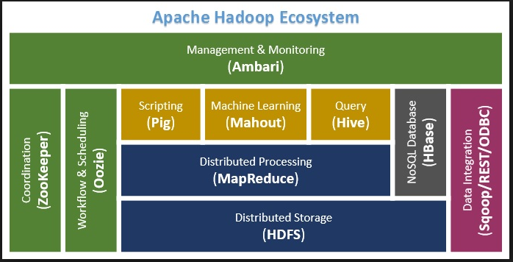
BigData Components & Architecture:
(3, Anallytics)
BigData Analytics Components:
  Two core components of BigData Analytics: Apache Hadoop and HDFS
  BigData Analytics Dashboard Technologies: KNIME, IBM SPSS
  Analytics with AI: IBM SPSS, RapidMiner, Apache Pinot(OLAP)
BigData Hadoop System Components :
  Distributed Processing Engine: Hadoop, Spark and Tez
  Distributed File System : HDFS and RDD
  Data Warehouse System : HBase
  Scripting/Query : Pig and Hive
  Database System : NoSQL, Cassandra
  Data Analysis Platforms : Hive, Spark, R/Octave/MATLab, BIRT, KNIME & IBM SPSS
  Monitoring : Apache Amber
  Machine Learning API/Platforms : Mahout, Spark, MATLAB, Google TensorFlow, Quantum Machine Learning, CML(Cloudera Machine Learning)
  Distributed Networks : Blockchain SWARM Intelligence

Slide 7
Data Lake and Database Systems:
(1, Technology)
Data Lake:
  “ A Data Lake is centralized repository designed to store, process and secure BigData- large amount of structured, semi-structured and unstructured data”
  Data Warehouse with BigData Technologies
  Engineered for Security Analytics, Business Analytics...
Benefits of Data Lakes:
  Advanced Analytics Support- Machine Learning, QML and Mobile Machine Learning
  Scalability, Heterogeneous Data Formats
  Data Quality Assurance, Democratized Architecture
  Better Performance
Database Systems In DataLakes:
  Relation Database Systems : MySQL, IBM DB2, Oracle Database, MS SQL Server...
  N0-SQL Database Systems : Cassendra, No-SQL
  Embedded Database Systems:
  OLAP Systems : Apache Pinot

Slide 8
Data Lake and Database Systems:
(2, Architecture And Design
Data Lake Platforms:
  BigData Processing Engine- Hadoop, Spark
  Analytics
  ?
Data Lake Architecture( Generic):
Design Frameworks and Standards:
  Secure By Design And DevSecOps:
  Zero Trust Architecture: NIST 300-161, TOGAF :
  BigData System Design Engineering :
  Functional Compliances: PCI-DSS, HIPAA, SOX, GLBA,
Design Tools:
  Secure By Design:

Slide 9
BigData And AI On Cloud Platforms:
BigData On Cloud:
  Cost Effective Architecture
  Less Expensive and Lower TCO
  Customer Support and Community Support
  Availability of SLA
AI Cloud Platforms:
  Easy to Maintain and Deploy
  General Trend....
Native Clouds Platforms:
  Nutanix Cloud Native , https://www.nutanix.com
  General Trend....

Slide 10
BigData Developer Platform-Hadoop, Spark & Scala:
Labs Environment Options:
  CCA-176 Registration Free – preloaded with Apache Spark
  CDP Trial Access
  CDP In-House
  Open Source BigData Environment- Hadoop, Spark and Scala(Windows and Linux)
    Hadoop: https://hadoop.apache.org/
    Spark : https://spark.apache.org/
    Scala : https://www.scala-lang.org/
Programming:
  Java and MapReduce : Eclipse with Plugins
  Python for Machine Learning : PyCharm
  Scala for Data Analysis : IntelliJ
  Java+Python+Scala : Eclipse

Slide 11
PyTorch On- Windows and Linux:
PyTorch On Windows:
  Install PyTorch, pip3 install torch torchvision torchaudio
  (https://pytorch.org/get-started/locally/)
  Install Pilchard Edu(Free ) and install PyTorch API
  (https://www.jetbrains.com/edu-products/download/#section=idea-Scala)
  Create Example Models on Data Analysis or clone from https://github.com/amritchhetribrcs
PyTorch On Linux:
  Install PyTorch with installation matrices( CPU), details <URL>
  Install Pilchard Edu(Free ) and install PyTorch API
  Create Example Models on Data Analysis or clone from <>

Slide 12
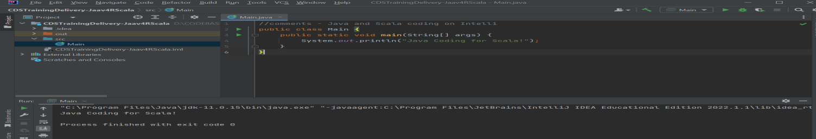
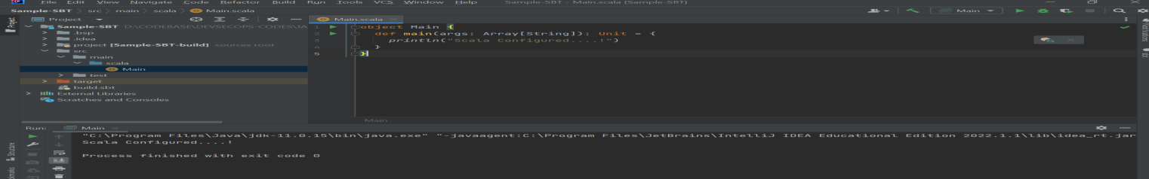
Labs. Of Session 1- On BigData Technology:
Java Basic for Scala Programming:
1. Get IntelliJ from <> and install
2. Create Java Project - CDSTrainingDelivery-Jaav4RScala
3. Create example codes and run
Scala with GoLand IDE:
1. Get GoLand IDE from <> and install
2. Get Scala SDK from
2. Configure Scala IDE
Scala with IntelliJ IDE(Edu Free):
1. Get IntelliJ from <> and install
2. Configure Intellij for Scala – either using sbt or Intellij Build Systems
2. Write Codes and Start coding

Slide 13
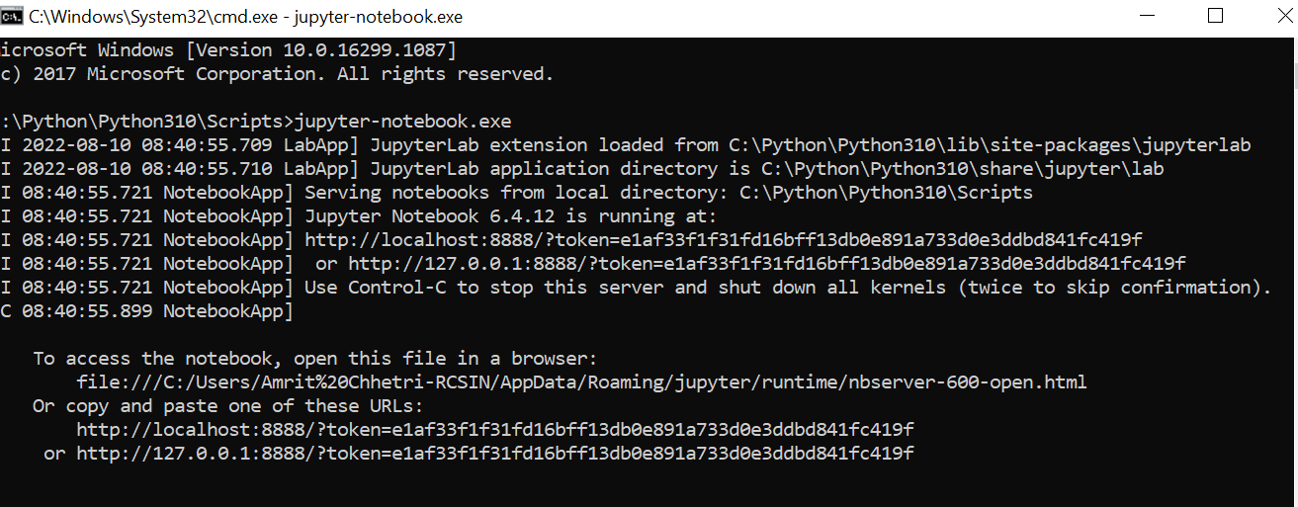
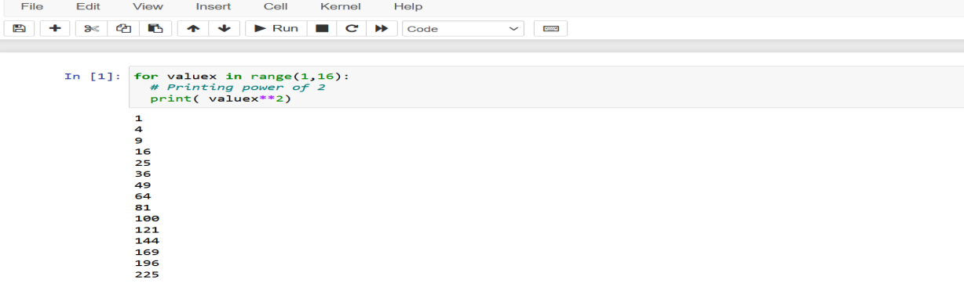
Labs. Of Session 2- On BigData Technology:
Python Programming:
Python Coding with PyCharm:
1. Get PyCharm IDE from <> and install
2. Get Python SDK from
2. Create Project and start coding
Python Coding with Jupyter Notebook:
1. Install Jupyter Notebook using details from
2. Start Jupyternotebook jupyter-notebook.exe
3. Access it on Local Browser and start coding

Slide 14
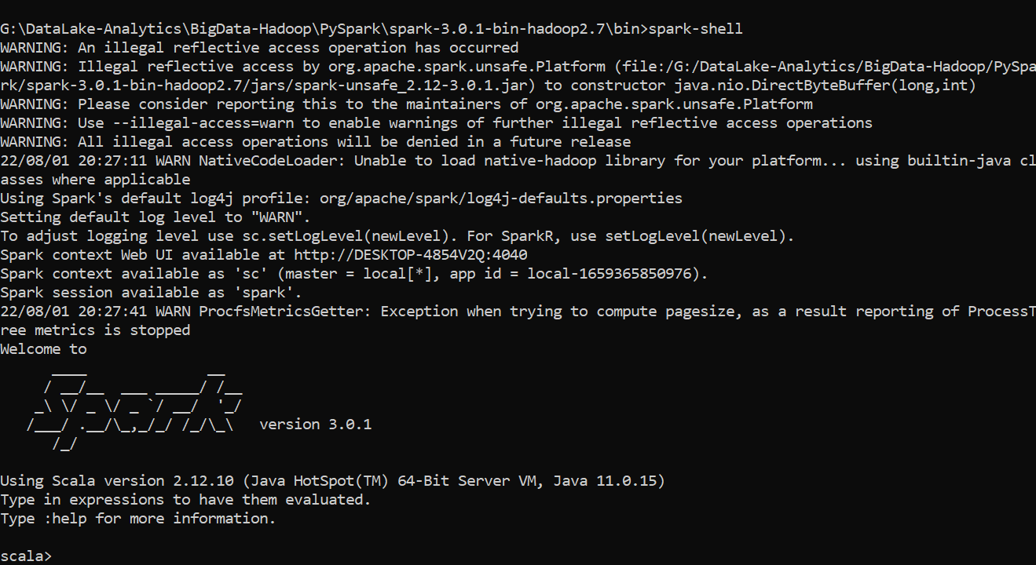
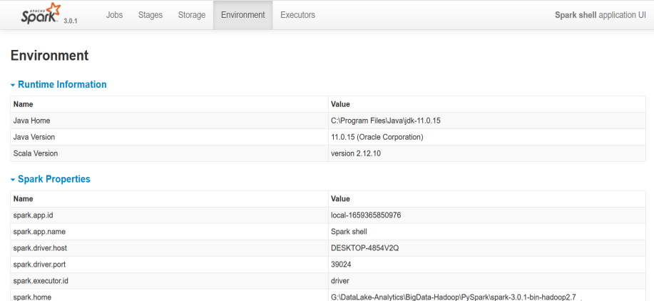
Labs. Of Session 3- On BigData Technology:
PySpark On Windows Installation -Steps:
1. Get PySpark supported version as Support Matrices
2. Create “DataLake-Analytics” folder and unzip tar aka zipped file
3. Create two System Environment Variables – HADOOP_HOME and SPARK_HOME
,X:\DataLake-Analytics\BigData-Hadoop\PySpark\spark-3.0.1-bin-hadoop2.7
4. Run spark-shell.cmd to start Spark Instance
5. Start Firefox and check the installation with http://<IP Address>:4040
PySpark On Linux Installation -Steps:
1. Get PySpark supported version as Support Matrices
2. Create “DataLake-Analytics” folder and unzip tar aka zipped file
3. Update variable HADOOP_HOME and SPARK_HOME in bashrc or profile file
4. Start Firefox and check the installation with http://<IP Address>:4040

Slide 15
CDP Access And Administration(Basics):
CDP Access by Enterprise:
1. Considerations: Functions and Features, SLA, Data Security Assurance & Frameworks
2. Product Evaluation and purchasing CDP
3. Platform Access
Administration:
1. User and Access Management
2. Data Security Compliance Management
3. System Security, Cyber Insurance and Data Security
4. Patch Management and Maintenances

Slide 16
BigData Quotient Assessment-Short Hackathons,CTFs & Quiz:
Hackathon Problem Statement 1:
An Startup specializing in Embedded Machine Learning for IOMT( Internet Of Medical Things) need a Solution to determine Operational Statistics of IOT Devices in Real-Time. They decided to create Digital Model of Physical Sensors to detect Operational Statistics- Temperature, Motor Roations, Chemicals around, Humidity. If you were System Designer, what are top challenges you need to address?
2. Hackathon Problem Statement 2:
An Startup specializing in Embedded Machine Learning for IOMT( Internet Of Medical Things) need a Solution to determine Operational Statistics of IOT Devices in Real-Time. They decided to create Digital Model of Physical Sensors to detect Operational Statistics- Temperature, Motor Rotations, Chemicals around, Humidity. If you were System Designer, what are top challenges you need to address?
3. Rules of Submission:

Slide 17
BigData Quotient Assessment-Short Hackathons,CTFs & Quiz:
The Tool which is used in management of MS SQL Server Objects?
  MS SQL Server Management Studio
  Azure Studio
  Android Studio
  MS Visual Studio
Which Python Framework is used Web Programming?
  Beautiful Soup
  PennyLane
  TensorFlow
  Eclipse
Which can be used in ELT while Datasets for Machine Learning?
  Pentaho/Talend
  PyTorch
  OpenVINO Toolkit
  Azure Computer Vision
Which Android IDE can be used to design Intelligent Mobile Apps?
  Android Studio
  PyCharm
  Netron
  Jupytier Notebook
What is Data Lake?
  Data Warehouse with BigData Technologies
  It reservoir of Data and Services
  Collection Data from Lakes
  It is Biotechnology

Slide 18
BigData Quotient Assessment-Short Hackathons,CTFs & Quiz:
Hackathon Problem Statement 1: ( Submit by 3 Days):
An Startup specializing in Embedded Machine Learning for IOMT( Internet Of Medical Things) need a Solution to determine Operational Statistics of IOT Devices in Real-Time. They decided to create Digital Model of Physical Sensors to detect Operational Statistics- Temperature, Motor Roations, Chemicals around, Humidity. If you were System Designer, what are top challenges you need to address?
2. Hackathon Problem Statement 2:
Perform Internet-Based to understand “Secure By Design Principles” for BigData Analytics and write few recommendations for “Best Practices”
3. Hackathon Problem Statement 3:
  Download Data Science Hackathon details from <URL>
  Use Template to make/write your Solution to Problem/Ideas Statement
  Create Folder in this Google Drive and submit there/here.

Slide 19
References And Resources:
Certification Resources:
  Cloudera Free Courses: <url>
  Cloudera Developer Certification: <url>
Data Lake with Cloudera Technologies:
  Everyday Ethics for Artificial Intelligence, IBM https://www.ibm.com/watson/assets/duo/pdf/everydayethics.pdf
  Ethics of Artificial Intelligence and Robotics, Stanford - https://plato.stanford.edu/entries/ethics-ai/#AIRobo
Smart :
  AI Ethics, MIT Press- https://mitpress.mit.edu/books/ai-ethics
  A Practical Guide to Building Ethical AI , Harvard Business Reviews
  ,https://hbr.org/2020/10/a-practical-guide-to-building-ethical-ai
BigData Magazines and Journals:
  AI Ethics, MIT Press- https://mitpress.mit.edu/books/ai-ethics
  A Practical Guide to Building Ethical AI , Harvard Business Reviews
  ,https://hbr.org/2020/10/a-practical-guide-to-building-ethical-ai
Installation and Configurations Details:
Data Lake Configuration Master: <GitHub/Google Drive URL>
Machine Learning Configuration Master: GitHub/Google Drive URL>

Slide 20
THANK YOU ALL
Spark and BigData Training Materials
Reference Guides: https://drive.google.com/drive/folders/1bek8gOnDzqvNPdlUY7s4_Qt14epnK4Kz?usp=sharing
Presentation : https://drive.google.com/drive/folders/1VvxnbeFMqy_w2zXEbchIx0B_MhffwgPV?usp=sharing
Practivce Codes : <>

